Slide 1
Email Classification
Case De-Brief
Hitesh Sharma
hitesh717sharma@gmail.com

Slide 2
Content
Section A:
Problem Statement
Data Gathering
Exploratory Data Analysis (EDA)
Approach
Results
Section B:
Source Code

Slide 3
Section A

Slide 4
Problem statement
This project addresses a real life business challenge of IT Service Management. This is one of the known challenges in IT industry where a lot of time is wasted in IT support ticket classification.
In Helpdesk, almost 30–40% of incident tickets are not routed to the right team and the tickets keep roaming around and around and by the time it reaches the right team.
This problem could have been solved easily if there was an automatic mechanism to route the incident ticket to the right category and right team.
Also ticket information can be used to showcase trend analysis (if the data is sufficiently large) in order to gain valuable insights on peak seasons and relocate resources accordingly.

Slide 5
Dataset
The dataset is pulled directly from Service now. The initial data pre-processing includes cleaning of data (removing duplicates, removing empty rows, removing stop words etc.)
Note : The dataset used for the POC is a dummy dataset (Confidential info)
Incident Number : The number assigned to the ticket
Request date : Date Time format
Summary : Contains the body of the Email sent
Request Type : Incident/Request
Affected CI : The affected instance
Assignment Group: The group assigned to the request
Resolver group: The group which finally resolved the issue

Slide 6
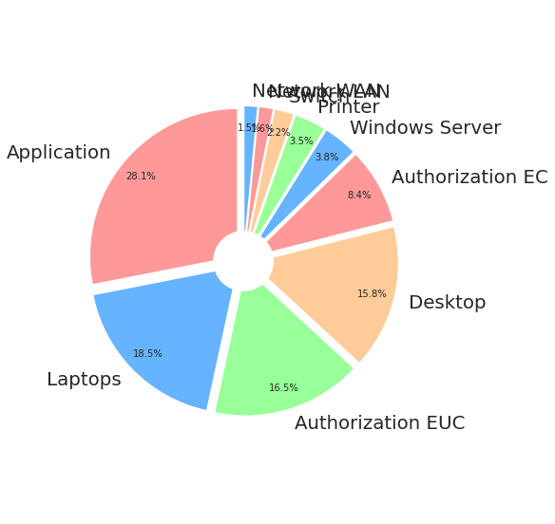
EDA: Outcome Distribution
Network WLAN
Network LAN
Switch
Printer
From the above distribution, we can clearly see that our training data is suffering from data imbalance problem.

Slide 7
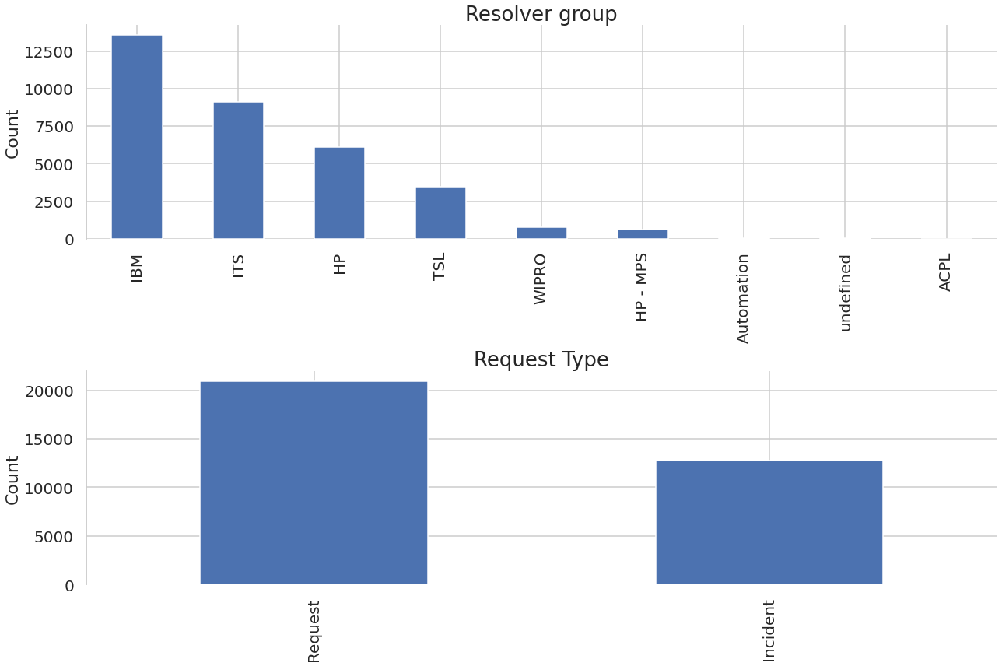
EDA:Resolver and Request types
Most of the tickets are resolved by IBM , ITS teams. Thus looking more into what specific sub categories are their general issues can be of importance.
There are two types of request – Incident and Request

Slide 8
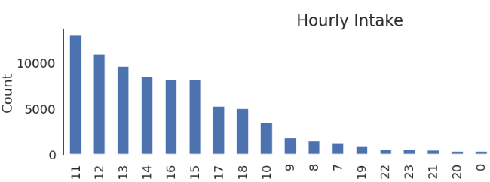
EDA: Datetime Features (Hourly intake)
During the mid-day the intake of the animals is significantly higher. Thus the feature can be grouped into morning , mid-day , night if the Hour feature is importance.
Weekdays can be analysed to showcase which days are usually hectic for IT Teams , so they can deploy resources accordingly

Slide 9
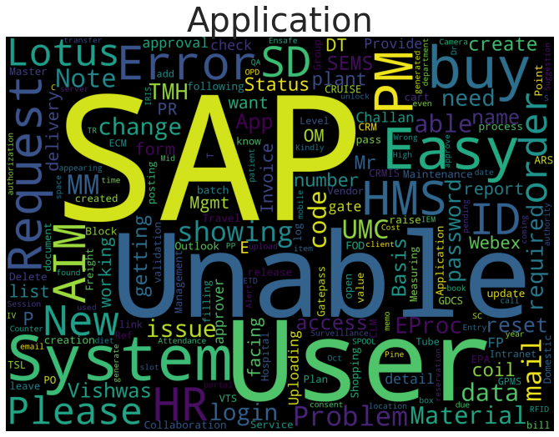
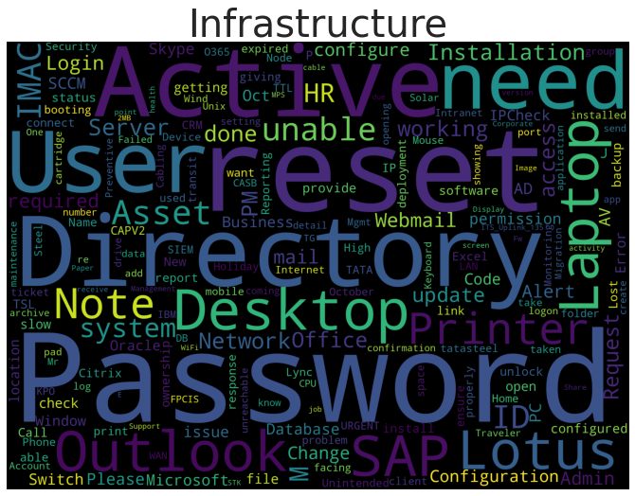
EDA: Word Clouds
.

Slide 10
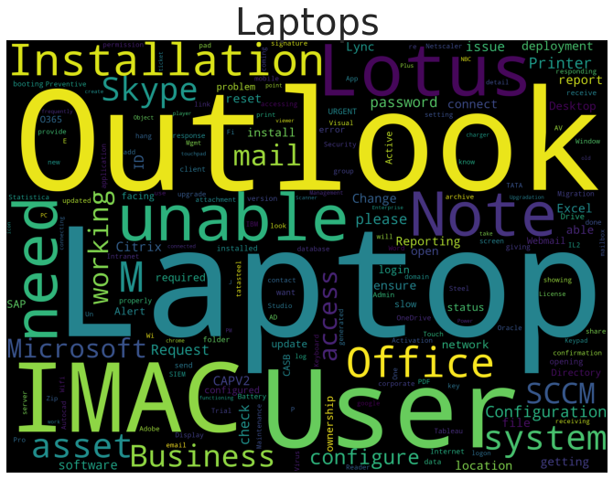
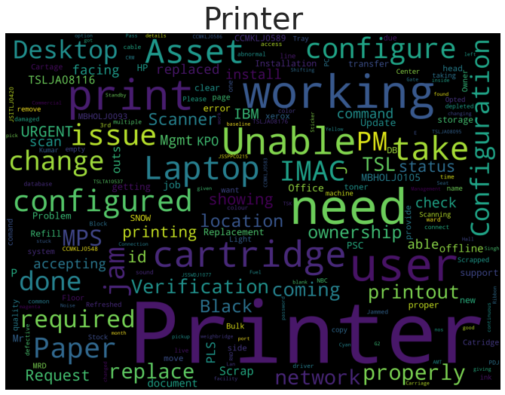
EDA: Word Clouds

Slide 11
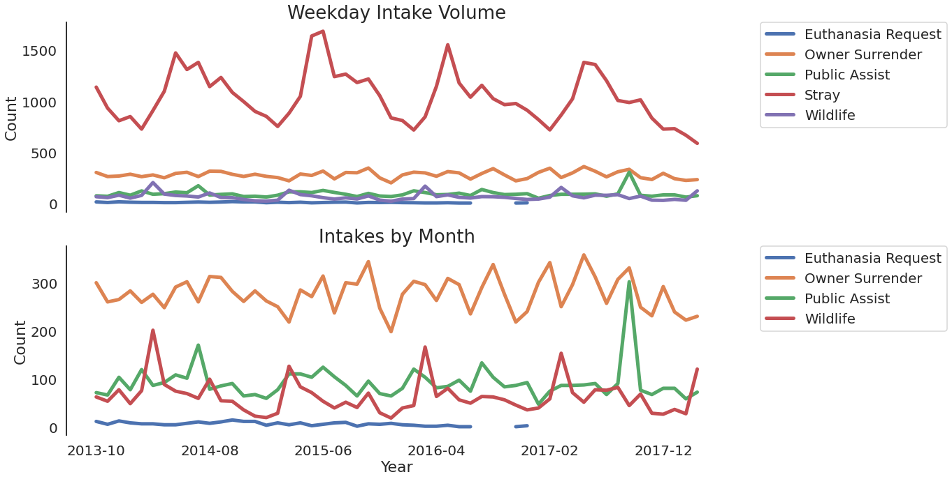
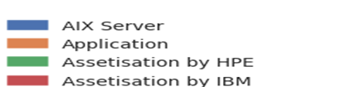
EDA: Trend analysis
Intake trend analysis
A normal assumption would be that the mails would a straight line with a few peaks.
However repetitive pattern is observed for sub categories with peaks (Jan-march) which indicates the high volume of incidents happening during the peak period.
Appropriate trend analysis could help IT teams better relocate resources.

Slide 12
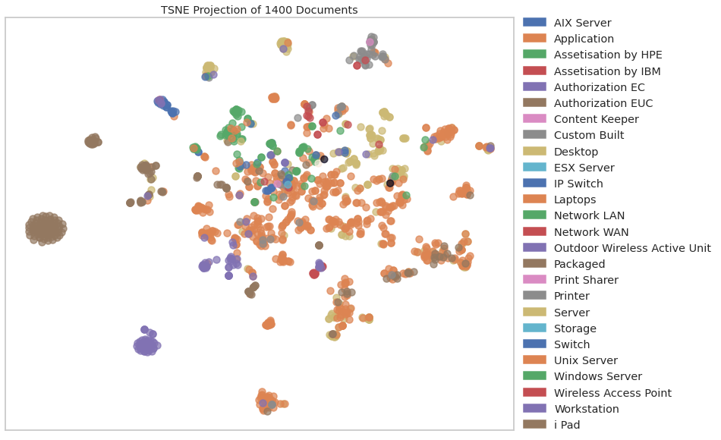
EDA: Clusters (Train Data)
Clear clusters are observed between various classes when Body of the emails is pre – processed and converted into feature vectors .
PCA can help as a dimensionality reduction method to observe further clear clusters / better classification.

Slide 13
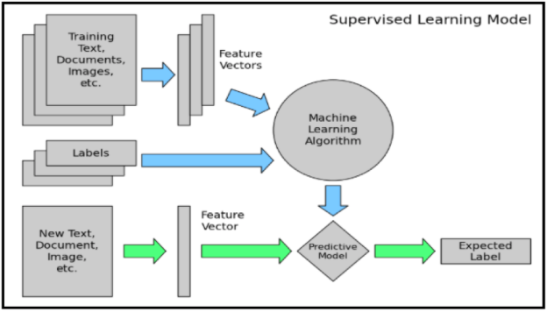
Modelling approach

Slide 14
Data Pre-Processing
Data formatting:
Changing the data format into suitable types such as date time , category , float etc.
Dropping date-time columns from which features have already been extracted.
Imputing/deleting missing values
Defining category features
NLP Pre-processing step for ‘Summary’ column (stop word removal , stemming , contraction mapping, cleaning corpus)
Category Features:
One – Hot encoding category features
Using vectorisation methods to convert summary column into feature vectors. Approx. 5k features(tfidf,Bow)
Dimensionality reduction (PCA ) – 1200 features explain 85% of the variance
Numeric Features
Standard scaling all the numeric features.

Slide 15
Model Selection
We split(stratified) data into train and validation datasets in 80:20 ratio.
After training all proposed models, we measured their accuracy on validation data and chose the model giving the best score.
Model | F1 Score
DecisionTreeClassifier | 0.62
RandomForestClassifier | 0.839
SVM | 0.75
Naïve Bayes | 0.78
XGBClassifier | 0.85
XGB Classifier performed best on validation set.
After cross validation , feature tuning the final model gave a F1 score of 0.89

Slide 16
Section B

Slide 17
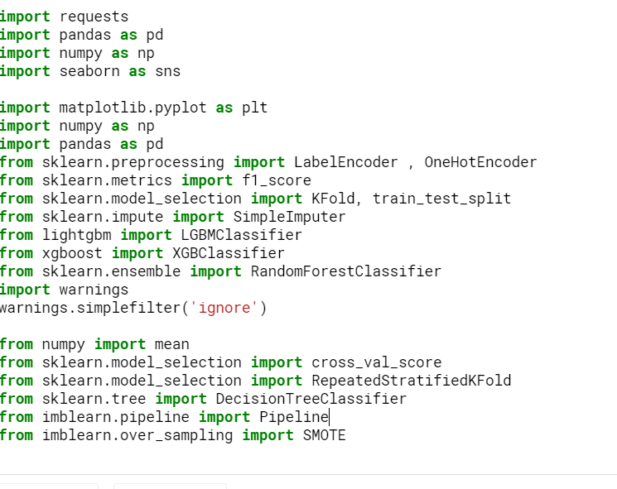
Source Code
Importing packages/libraries

Slide 18
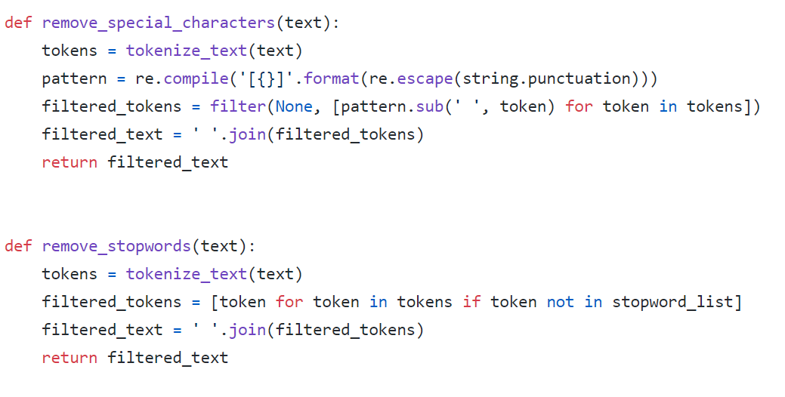
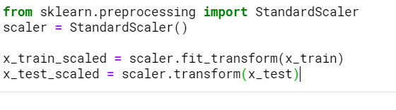
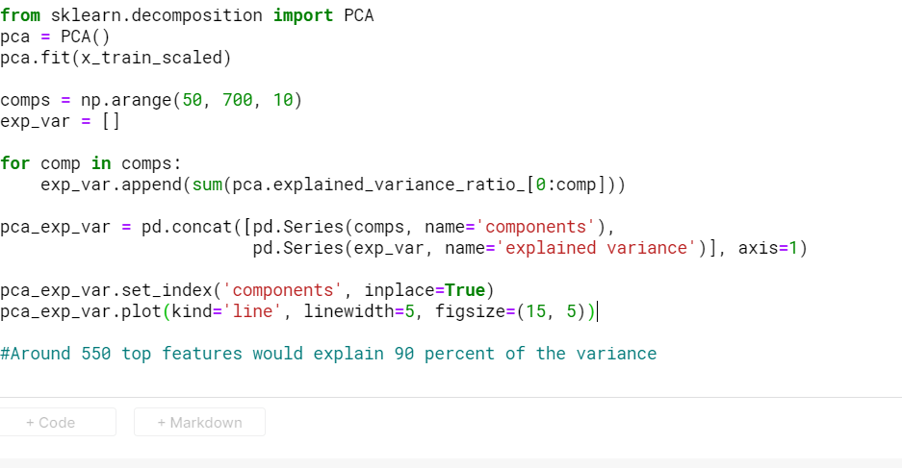
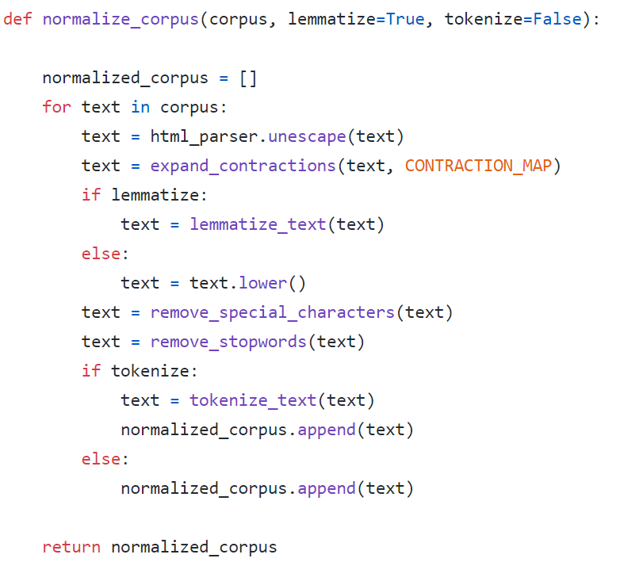
Source Code
NLP Pre Processing
Pre-processing functions
Dimensionality reduction

Slide 19
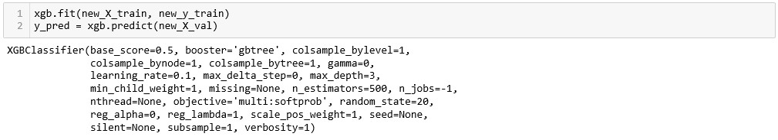
Source Code
Model - XGBClassifier

Slide 20
THANK YOU

